Slide 1
Final Project delivery 8
Team 12
Alejandro López
Benjamín Moreno

Slide 2
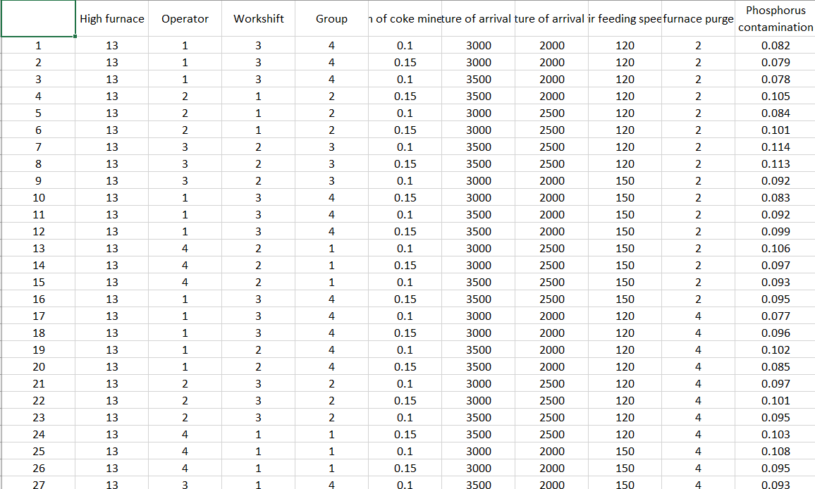
Data
Data came from Altos hornos de México, and it is the record of phosphorous contamination of steel and the variables involved in the process.

Slide 3
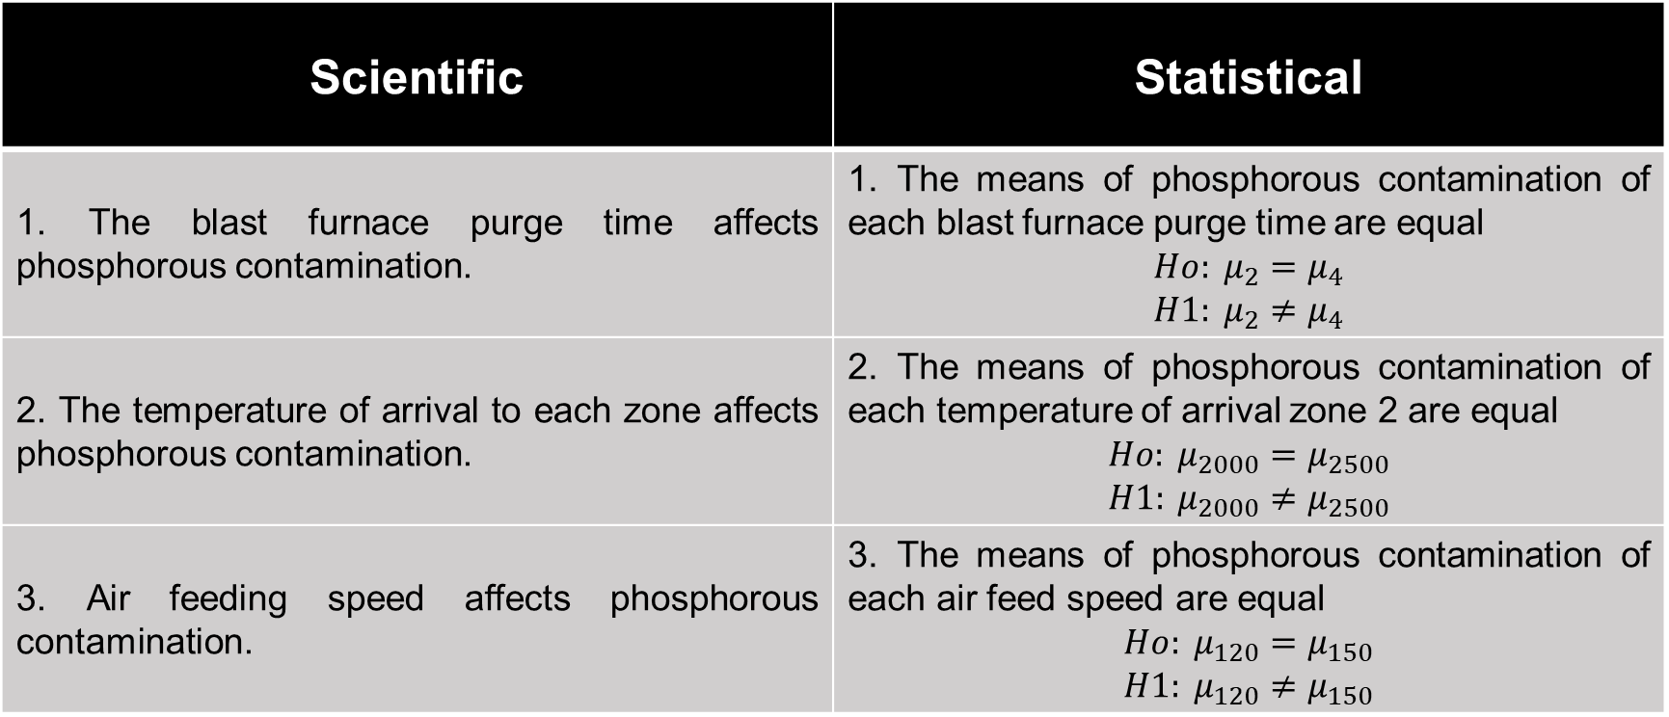
3 scientific and 3 corresponding statistical hypotheses.
Scientific | Statistical
1. The blast furnace purge time affects phosphorous contamination. | 1. The means of phosphorous contamination of each blast furnace purge time are equal $${Ho: μ}_{2}=μ_{4}$$ $${H1: μ}_{2}≠μ_{4}$$
2. The temperature of arrival to each zone affects phosphorous contamination. | 2. The means of phosphorous contamination of each temperature of arrival zone 2 are equal $${Ho: μ}_{2000}=μ_{2500}$$ $${H1: μ}_{2000}≠μ_{2500}$$
3. Air feeding speed affects phosphorous contamination. | 3. The means of phosphorous contamination of each air feed speed are equal $${Ho: μ}_{120}=μ_{150}$$ $${H1: μ}_{120}≠μ_{150}$$

Slide 4
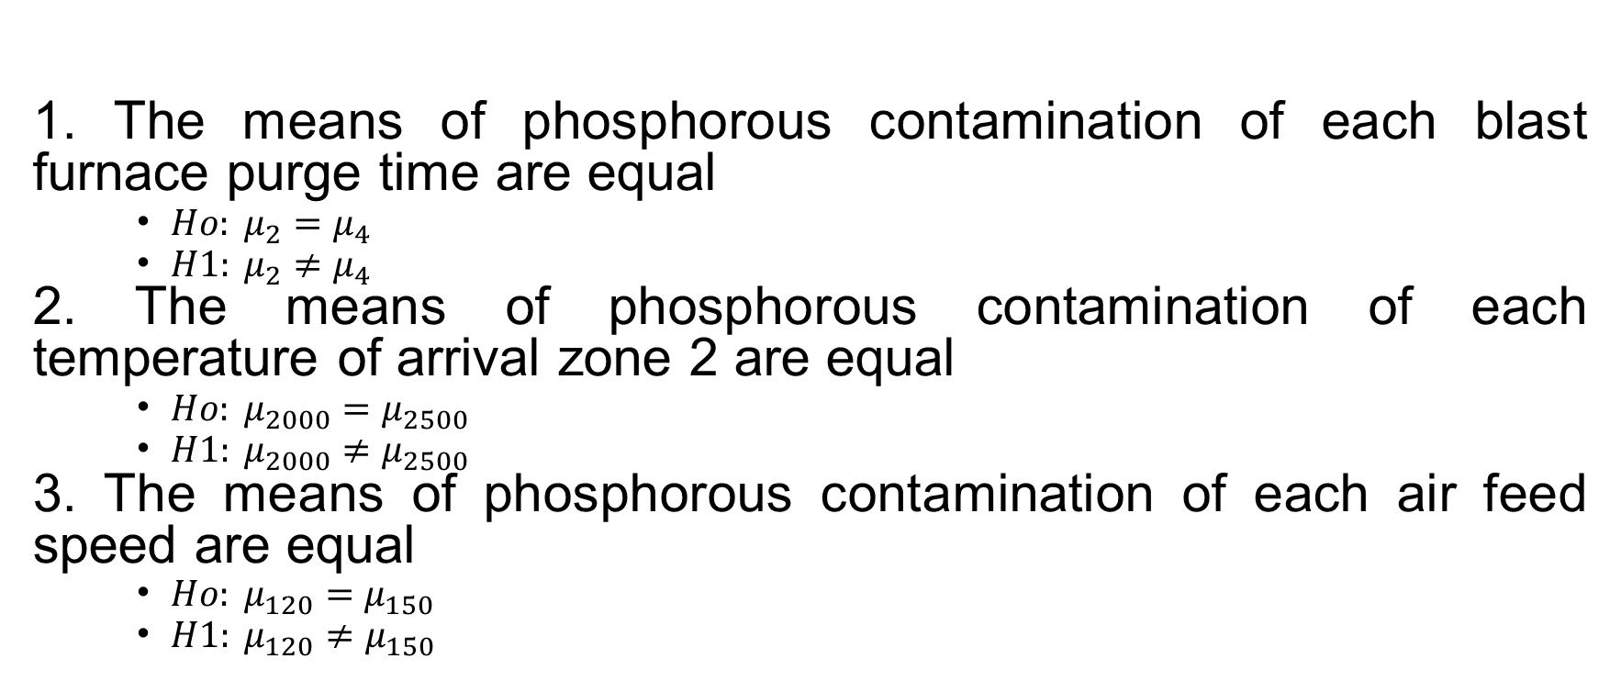
Explain all statistical hypotheses in a mathematical format
Statistical
1. The means of phosphorous contamination of each blast furnace purge time are equal
${Ho: μ}_{2}=μ_{4}$
${H1: μ}_{2}≠μ_{4}$
2. The means of phosphorous contamination of each temperature of arrival zone 2 are equal
${Ho: μ}_{2000}=μ_{2500}$
${H1: μ}_{2000}≠μ_{2500}$
3. The means of phosphorous contamination of each air feed speed are equal
${Ho: μ}_{120}=μ_{150}$
${H1: μ}_{120}≠μ_{150}$

Slide 5
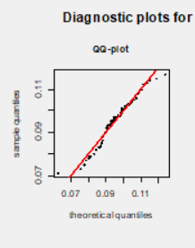
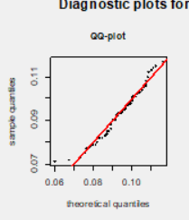
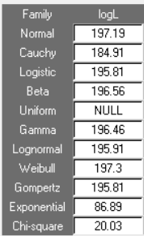
Distribution
Normal
Weibull
We selected Normal distribution based on:
Phosphorous contamination is a percentage, and it is measured as continuous numbers.
QQ plot has only 4 points out of straight-line behavior, and Weibull has more in the upper part.
LogL values are not far away, both are the highest values.

Slide 6
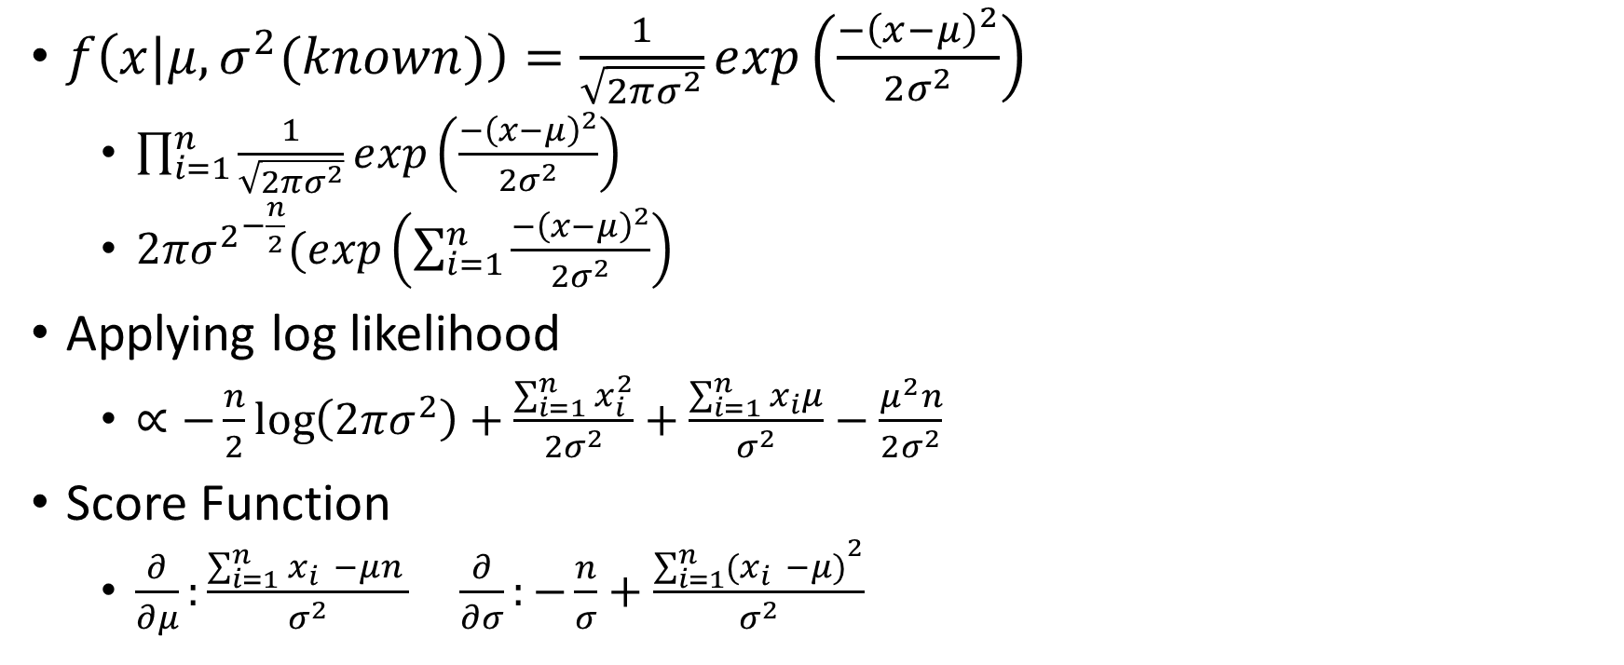
Fisherian approach using logL (MLE)
$f\left(x|μ,σ^{2}(known)\right)=\frac{1}{\sqrt{2πσ^{2}}}ⅇxp\left(\frac{−{\left(x−μ\right)}^{2}}{2σ^{2}}\right)$
$\prod_{i=1}^{n}{\frac{1}{\sqrt{2πσ^{2}}}ⅇxp\left(\frac{−{\left(x−μ\right)}^{2}}{2σ^{2}}\right)}$
$2π{σ^{2}}^{−\frac{n}{2}}(ⅇxp\left(\sum_{i=1}^{n}{\frac{−{\left(x−μ\right)}^{2}}{2σ^{2}}}\right)$
Applying log likelihood
$∝−\frac{n}{2}\log\left(2πσ^{2}\right)+\frac{\sum_{i=1}^{n}{x_{i}^{2}}}{2σ^{2}}+\frac{\sum_{i=1}^{n}{x_{i}μ}}{σ^{2}}−\frac{μ^{2}n}{2σ^{2}}$
Score Function
$\frac{∂}{∂μ}:\frac{\sum_{i=1}^{n}{x_{i } −μn }}{σ^{2}}$ $\frac{∂}{∂σ}:−\frac{n}{σ}+\frac{{\sum_{i=1}^{n}{{(x}_{i } −μ)}}^{2}}{σ^{2}}$

Slide 7


Applying MLE
$\frac{\sum_{i=1}^{n}{x_{i } −μn }}{σ^{2}}=0$ $→\hat{μ}=\frac{\sum_{i=1}^{n}{x_{i }}}{n}$
$−\frac{n}{σ}+\frac{{\sum_{i=1}^{n}{{(x}_{i } −μ)}}^{2}}{σ^{2}}=0$ $→\hat{σ^{2}}=\frac{{\sum_{i=1}^{n}{{(x}_{i } −μ)}}^{2}}{n}$

Slide 8
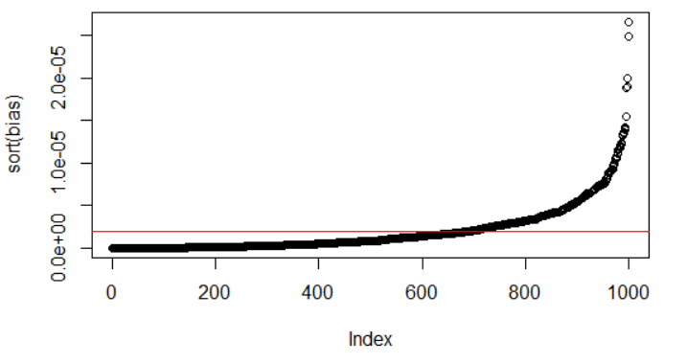
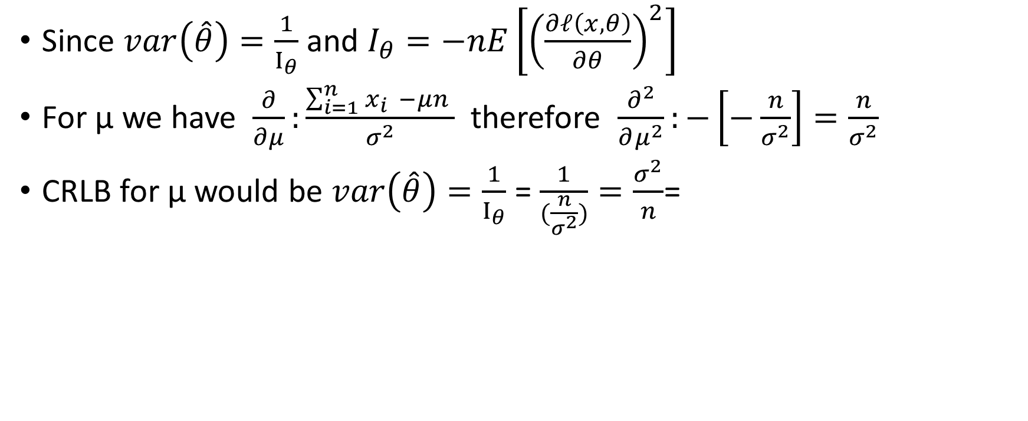
CRLB
Since $var\left(\hat{θ}\right)=\frac{1}{Ι_{θ}}$ and $I_{θ}=−nE\left[{\left(\frac{∂ℓ\left(x,θ\right)}{∂θ}\right)}^{2}\right]$
For µ we have $\frac{∂}{∂μ}:\frac{\sum_{i=1}^{n}{x_{i } −μn }}{σ^{2}}$ therefore $\frac{∂^{2}}{∂μ^{2}}:−\left[−\frac{n}{σ^{2}}\right]=\frac{n}{σ^{2}}$
CRLB for µ would be $var\left(\hat{θ}\right)=\frac{1}{Ι_{θ}}$ = $\frac{1}{(\frac{n}{σ^{2}})}=\frac{σ^{2}}{n}$=

Slide 9

Bayesian approach
Since phosphorous contamination $\sim N\left(x,μ\right)$
Prior$\sim N\left(μ\right)$
Likelihood $\sim N\left(x|μ,σ^{2}\right)with know standard deviation$
Posterior $\sim N\left(μ|x\right)$

Slide 10
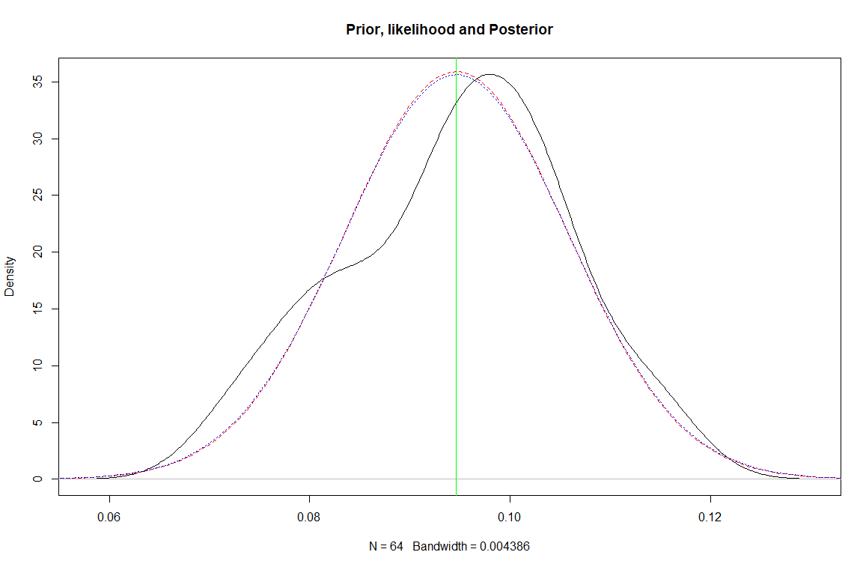
Bayesian approach
Prior
Likelihood
Posterior

Slide 11
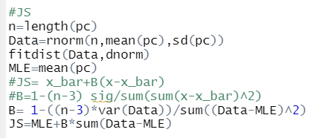


JS estimator
Since data behaves normally
${\hat{μ}}^{JS}=\hat{M}+\hat{B}\left(x_{i}−\hat{M}\right)$

Slide 12
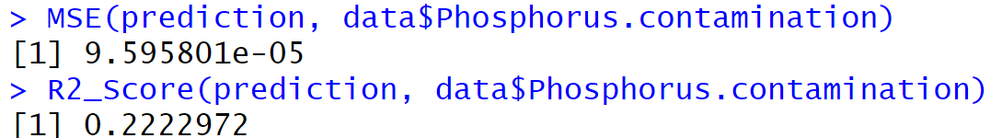
GLM
Created with the variables:
Temperature of arrival to zone 2
Air feeding speed
Purge time of the furnace

Slide 13
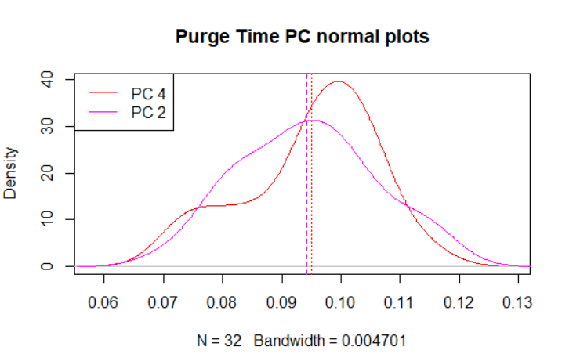
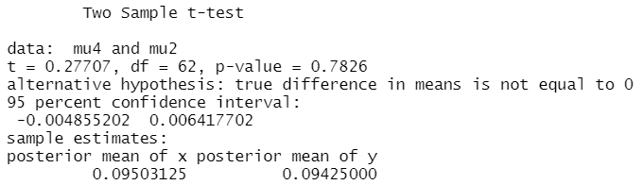

Hypothesis testing
1. The means of phosphorous contamination of each blast furnace purge time are equal
${Ho: μ}_{2}=μ_{4}$
${H1: μ}_{2}≠μ_{4}$
H0 is not rejected, there is not a true difference in phosphorous contamination means of each purge time

Slide 14
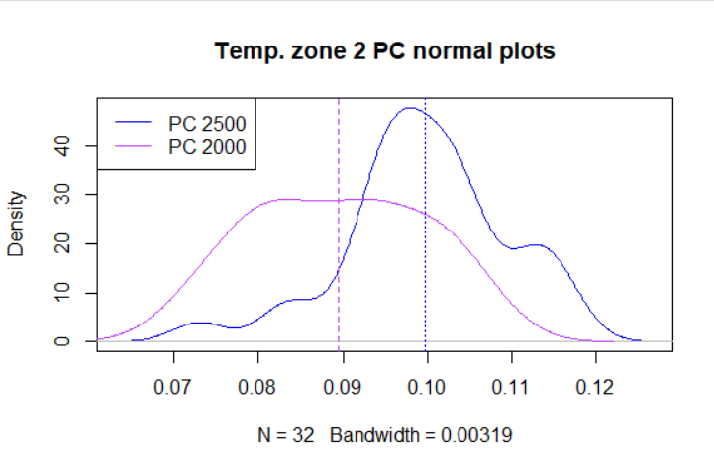
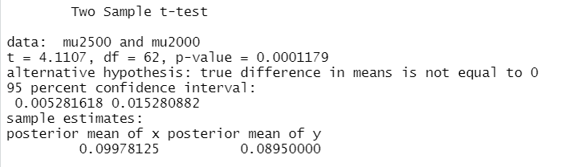

Hypothesis testing
2.The means of phosphorous contamination of each temperature of arrival zone 2 are equal
${Ho: μ}_{2000}=μ_{2500}$
${H1: μ}_{2000}≠μ_{2500}$
H0 is rejected, there is a true difference in phosphorous contamination means of each temperature

Slide 15
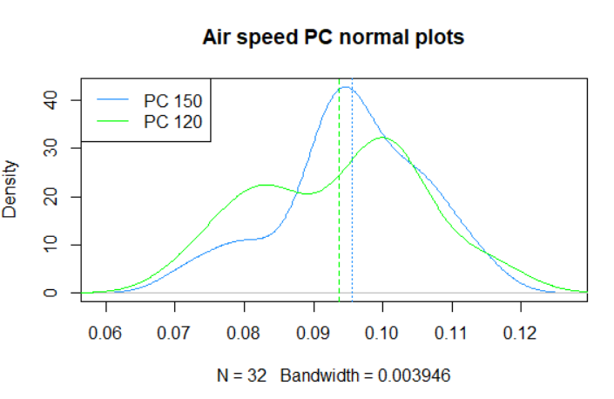
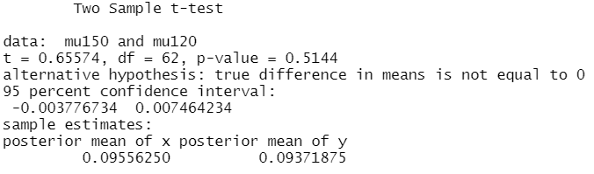

Hypothesis testing
3.The means of phosphorous contamination of each air feed speed are equal
${Ho: μ}_{120}=μ_{150}$
${H1: μ}_{120}≠μ_{150}$
H0 is not rejected, there is not a true difference in phosphorous contamination means of each air feed speed

